Slide 1





Slide 2
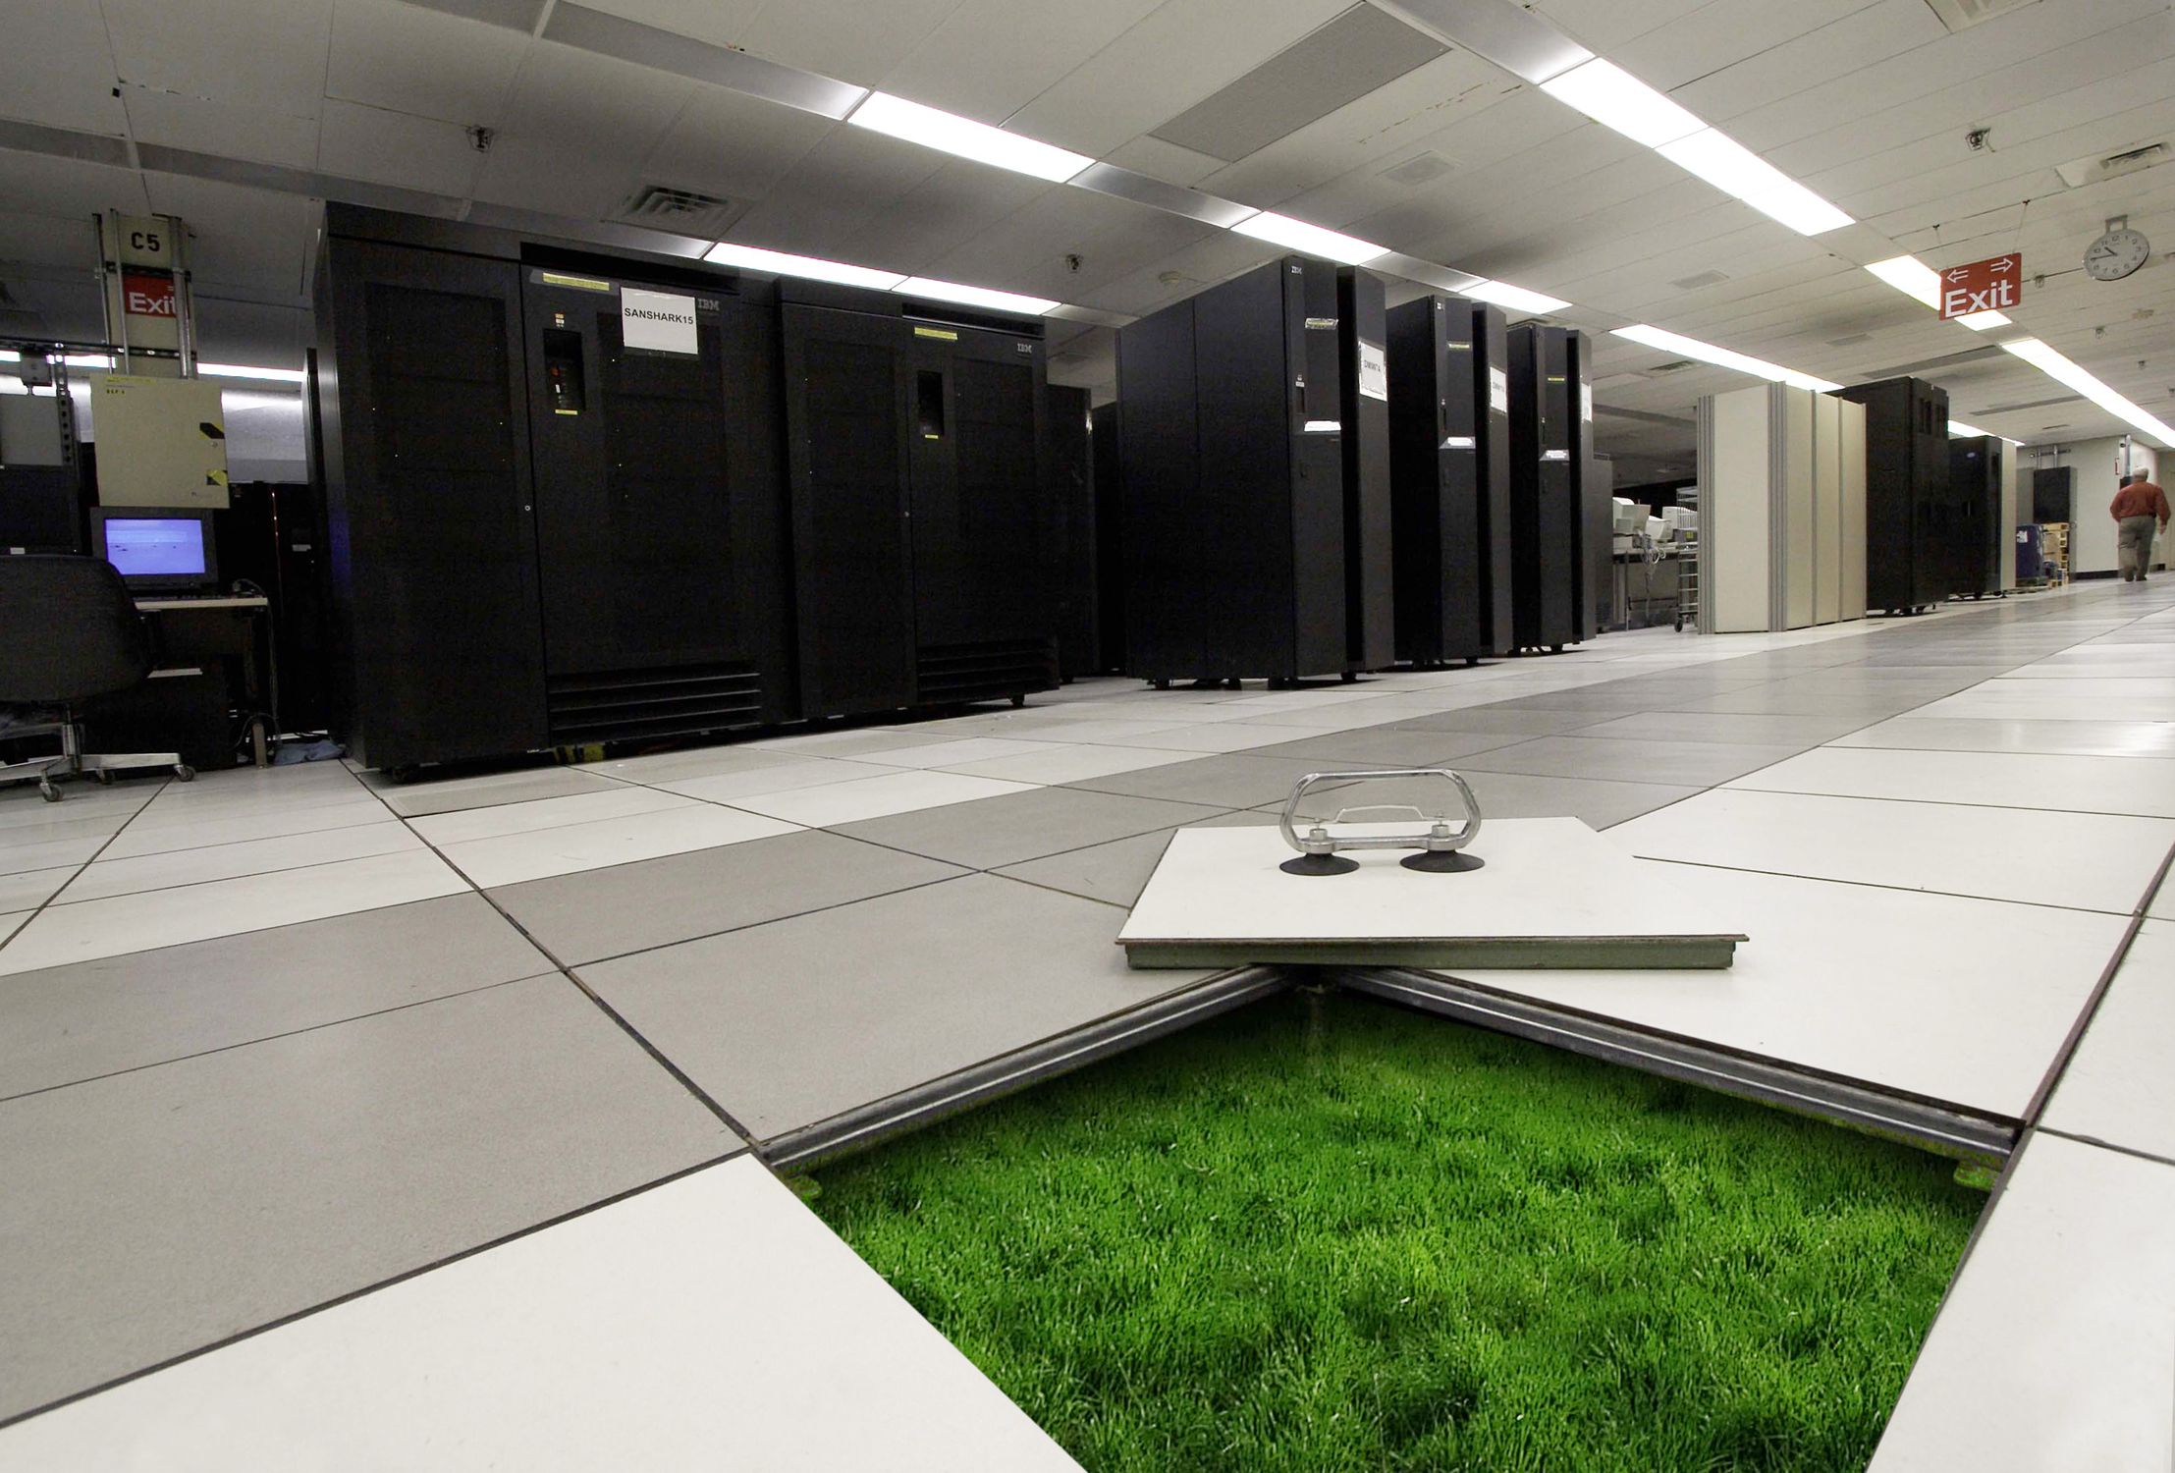
Arquitecturas de Centro de Datos
Para empresas en crecimiento
Gustavo Giaccio Systems Engineer

Slide 3
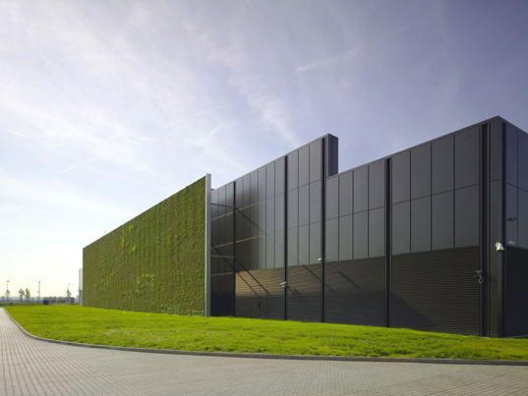

Que sabemos de Nexus
Que es ?
Cuales son sus diferenciales ?
Cuales son las diferencias con los Catalyst ?
Como es su arquitectura ?

Slide 4
Los objetivos de la presentación son: presentar una overview y un update sobre la familia Nexus y algunas arquitecturas para los Centros de Datos en función de los requerimientos actuales del negocio de la empresas en crecimiento ”
Gustavo Giaccio

Slide 5
AGENDA
Introducción FCoE
Nexus Update
Arquitectura General
Diseños

Slide 6


Evolución de Data Center 3.0
Unified Computing
Location
Freedom
HW
Freedom
Provisioning
Freedom
Consolidation
Virtualization
Automation
Utility
Market
Inter-Cloud
Private Clouds
Unified Computing
Unified Fabric
Data Center Networking
Notes:
6
6
6
Data Center Evolution Path to business alignment: The biggest IT issue today is a lack of flexibility, which is exactly what is required to keep pace with rapidly changing business conditions.
Today’s Data Center optimization initiatives are key catalysts to bringing:
Consolidation for standardization
Virtualization for asset optimization
Automation for improved service delivery.
Beyond automation, you begin to enter the next level of IT refinement with robust utility pay-as-you-go services offered within:
Enterprise intranet-class cloud utility services and
Inter-cloud go-to-market value deliver chain services for development and delivery of customer consumables.
Virtualization is changing the DC architecture
Unified computing is an architecture focused at the driving cohesion and simplification to our customers on this journey.

Slide 7
Data Center Business Advantage
At the heart of Business Innovation
New Service Creation and Revenue Generation
Driving Profitability
New Bus. Models, Governance and Risk
BUSINESS VALUE
Efficient
Agile
Transformative
Cisco Lifecycle Services
Policy
Partner Ecosystem
SOLUTION DIFFERENTIATION
Consolidation
Virtualization
Automation
Cloud
Open / Standards
App. Performance
Energy Efficiency
Security
Continuity
Workload Mobility
SYSTEMS
EXCELLENCE
Unified
Fabric
Unified
Network Services
Unified
Computing
Three Pillars of Framework
Switching
Application Networking
Security
Storage
OS
Management
Compute
TECHNOLOGY
INNOVATIONS
Notes:
Today literally the Data Centers are at the heart of business transformation. As businesses of varying sizes look to Data Center consolidation and Cloud-based services, they’re realizing that every dollar of investment there has a ripple effect in terms of productivity and efficiency across the rest of the organization. Our customers are voting with their dollars making it the biggest line item on their Enterprise budget. Cisco is also viewing this as a strategic spend area.
Streamlining Data Center Agility and Efficiency helps transform Enterprise IT letting our customers
and cloud based services, they’re realizing that every dollar of investment in the data center and cloud, is providing a ripple effect on the rest of the organization in terms of productivity and efficiency.
With the advent of mobility (smart phones), concepts of anything as a services (XaaS) , cloud computing models the trends are definitely changing. This is s true inflection point in the industry, as organizations look to deliver application fluency and scale regardless of location or device. Within the Data center concepts like virtualization have taken root, and buzzwords of yesterday like VM awareness, workload mobility etc., are fast becoming the norm.
IT is no longer a cost center, but is viewed as a strategic asset. IT Transformation is leading to business transformation. The Data center is a key component of the overall IT strategy driving a significant portion of investments there.
Many CIOs are being measured on the business impact they can create . This means being accountable for new service creation and revenue generation, driving profitability and productivity and being flexible enough to deliver new business models with need-based governance and risk mitigation
Cisco is uniquely positioned to address these top CxO care abouts. Alongwith a rich partner ecosystem, Cisco can deliver solutions like Endpoint virtualization (VDI/VXI), Cloud Computing (Private/Public/Hybrid clouds), Workload consolidation and Business continuity to name a few.
The solution differentiation is made possible due to the emphasis Cisco places on Systems engineering. Cisco’s Unified Fabric and Unified Compute System approaches embody the network and compute led thrusts in the Data center that provide the foundation to deliver on true architectural flexibility, investment protection and lower TCO. They offer an open, scalable, hi-performance foundation on which to offer key network, compute and application-level services whether it be network, compute or application services. These address the new challenges that are arising in Data centers and across the rest of the enterprise today. Virtualization happens to be a new trend as well as a catalyst for change. Application performance and fluency across the data center and into the enterprise is increasingly becoming important with applications becoming more pervasive and device agnostic. Security is top of mind and trust-based security is key especially as companies move into cloud based models, virtual services etc. Energy Efficiency and management is increasingly important and our customers appreciate the thought that Cisco brings into play on understanding that. In a bid to simplify operational complexity and reduce costs, many of our customers are increasingly placing emphasis on automation. Finally with virtualization taking root, and with server capacities and spending flat lining, the need to better optimize the resources, and move workloads seamlessly and transparently across the organization is becoming imperative.
Cisco’s Unified Fabric and UCS pillars allows us to provide holistic solutions instead of silo’d answers. They go hand in hand with Cisco Life cycle services and our ability to provide management simplicity including through policy based managed.
A lot of these capabilities are built on the innovation engine from Cisco across our product portfolios. Whether it be switching, storage, compute or application services, to name a few, these are truly the best in the industry. These are standards-based and also help accelerate the innovations for our customers to drive efficiency, agility and transformation across their organization.
If you look at this, this is very similar to how we approach our customers with our borderless networks architecture. These are connected and linked to a common customer value proposition.

Slide 8
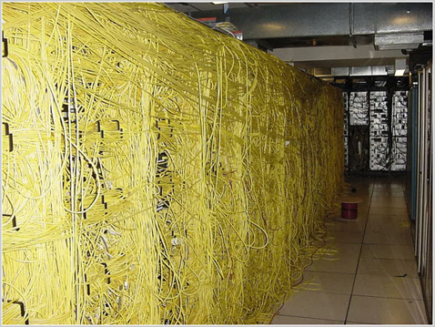
Unified Fabric
La Unificación de la Red

Slide 9
DC Design Details
Migration from 1G to 10G servers
10GBaseT Key Benefits:
10 Gigabit bandwidth requirements for 1 Gig NIC consolidation at the server access and virtual environments
Ease of 1GBASE-T to 10GBASE-T migration
Flexible, scalable cabling with standard RJ-45 connector, at distances up to 100m
Reuse of existing structured cabling
Economics of 1Gigabit Ethernet versus 10 Gigabit Ethernet
Prepare for Server LOM
Investment protection with 1/10G capabilities
Source: Crehan Research (Q4CY10)

Slide 10
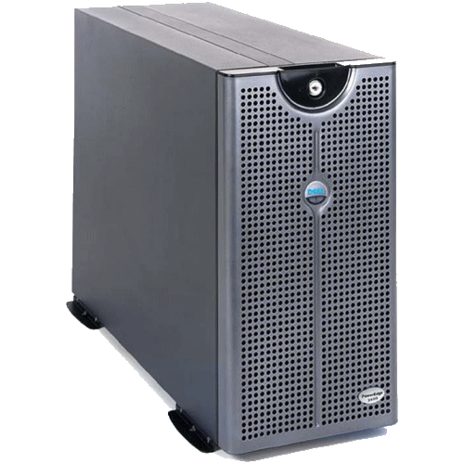
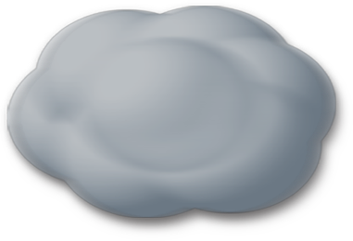
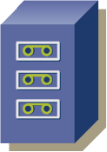




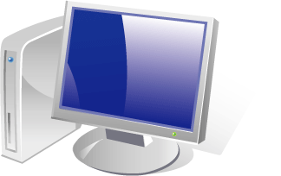
Unified IO
Increased Efficiency, Simpler Operations
Storage Network
LAN Network
Unified
Fabric
Unified Fabric and I/O
Notes:
10
Por lo tanto como veniamos viendo, anteriormente teniamos una gran variedad de redes, equipos, servidores.
Ahora cpon la virtualizacion, podemos bajar la cantidad de equipos y mejorar la utilizacion de los mismos.
Tamien podemos unir las redes en una unica red, utilizando la virtualizacion del equipamiento y podemos utilizar lo que llamamos Unified IO. Donde a traves de un unico enlace podemos tener las redes de comunicaciones y de Storage.
Unified I/O is part of this vision. If everything has a single connection to a network cloud, it can access all the other resources in that cloud. The idea of having separate connections for separate I/O functions or separate networks goes away.
The unifying network connection, in Cisco's view, is 10 Gigabit Ethernet. It can carry multiprotocol traffic, it can carry Fibre Channel (using Fibre Channel over Ethernet technology) and it can do RDMA
DAR Ejemplo de Convergencia de la Telefonia IP (Antes Telefonia + datos y ahora va todo junto...)

Slide 11
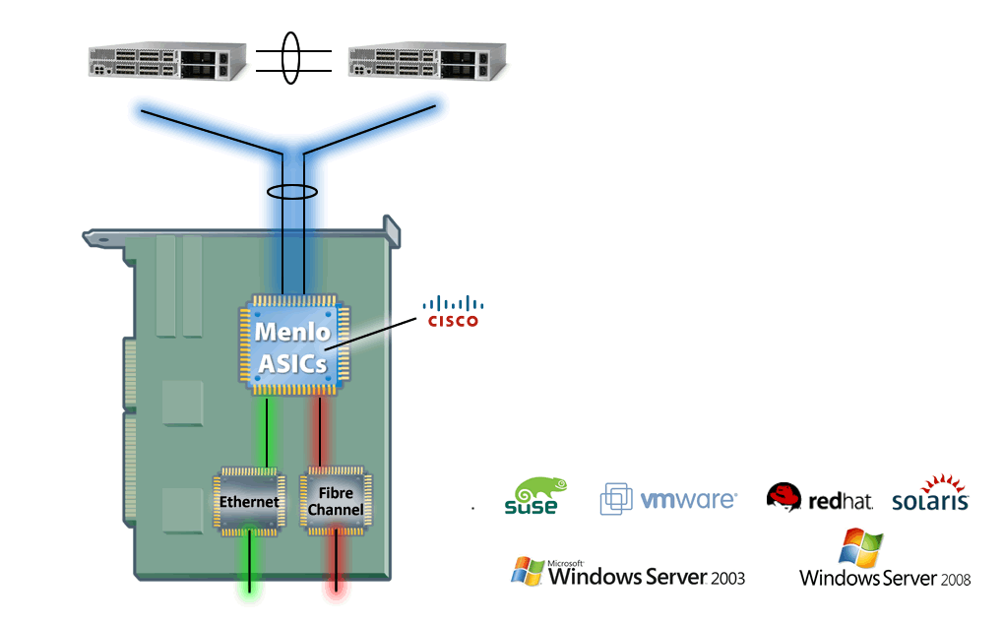
Converged Network Adapters (CNA)
Converged Network Adapters
Off-the-shelf NIC and HBA ASICs from QLogic
and Emulex, providing Dual Active-Active 10GE and FCoE connection
Support for Native Drivers and Stacks to minimize disruption for existing environments
Replaces multiple adapters per server, consolidating 10GE and Fibre Channel on a single interface
Supports Priority Flow Control and DCBX

Slide 12

4
2
16 Servers | Enet | FC | Total
Adapters | 20 | 20 | 40
Switches | 2 | 2 | 4
Cables | 40 | 40 | 80
Mgmt Pts | 2 | 2 | 4
16 Servers | Enet | FC | Total
Adapters | 20 | 0 | 20
Switches | 2 | 0 | 2
Cables | 40 | 0 | 40
Mgmt Pts | 2 | 0 | 2
Notes:
12
12
En este ejemplo vemos que en lo que anteriormente teniamos por ejemplo un rack con 16 servidores entonces:
20 adaptadores para la red de datos y 20 para la red de Storage (FC)
2 switches (redundancia) para datos y 2 ara Storage
40 cables para cada uno de las redes
2 puertos de management para cada uno de las redes
Y teniendo la posibilidad de virtualizar y Unified IO, podemos bajar todo esto a aproximadamente la mitad:
20 adaptadores para la red de datos
2 switches (redundancia) para datos
40 cables para red de datos
2 puertos de management datos
Y alli luego veremos como podemos diferenciar las redes de datos de las de Storage

Slide 13

Data Centre Evolution
IEEE DCB (Data Centre Bridging)
Feature / Standard | Standards Status
Priority Flow Control IEEE 802.1Qbb (PFC) | PAR approved, Editor Claudio DeSanti (Cisco), draft 1.0 published
Bandwidth Management IEEE 802.1Qaz (ETS) | PAR approved, Editor Craig Carlson (Qlogic), draft 0.2 published
Data Center Bridging Exchange Protocol (DCBX) | This is part of: Bandwidth Management IEEE 802.1Qaz
CEE (Converged Enhanced Ethernet) is an informal group of companies that submitted initial inputs to the DCB WGs.
Notes:
13
13
13

Slide 14
iSCSI and DCB
PFC (802.1Qbb) & ETS 802.1Qaz
Nexus 5000/5500 and F1/F2 line cards support DCB (PFC, ETS and DCBX)
Which mechanisms are beneficial for iSCSI
Core requirement is ensuring capacity (ETS)
Transmit Queues
Ethernet Link
Receive Buffers
One
One
Two
Two
Three
STOP
PAUSE
Three
Four
Four
Eight
Virtual
Lanes
Five
Five
Six
Six
Seven
Seven
Eight
Eight
Offered Traffic
10 GE Link Realized Traffic Utilization
3G/s
3G/s
2G/s
3G/s
HPC Traffic
3G/s
2G/s
3G/s
Storage Traffic
3G/s
3G/s
3G/s
3G/s
3G/s
3G/s
4G/s
6G/s
3G/s
LAN Traffic
4G/s
5G/s
t1
t2
t3
t1
t2
t3

Slide 15
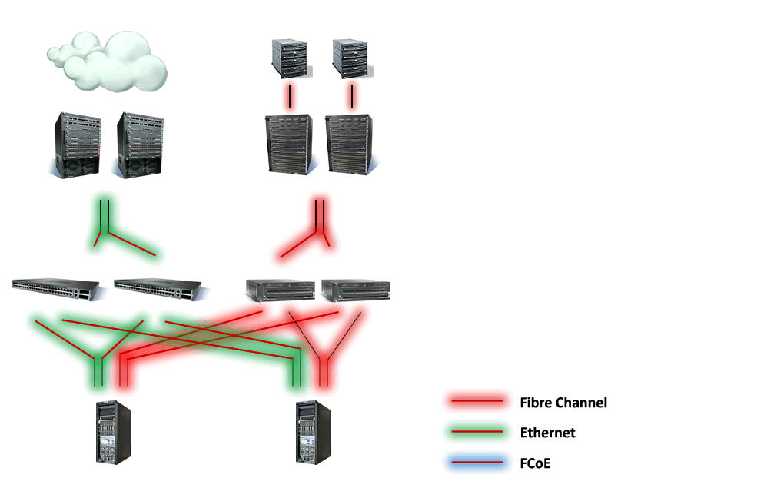
NON-Unified Fabric - Phase 0
A Segregated LAN and SAN…
In existing architectures, LAN and SAN connectivity is segregated directly from the Servers, where NICs and HBAs connect into Ethernet switches and Fibre Channel Fabrics. This may result in excess of 8+ cables to/from each physical server
In Ethernet, redundancy relies upon technologies such as Spanning Tree Protocol to provide a loop-free topology...

Slide 16
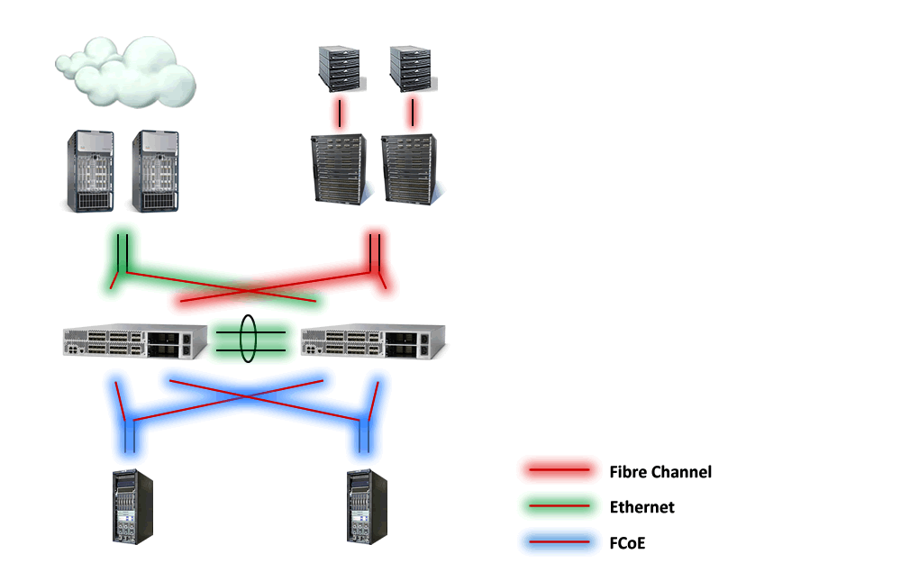
Unified Fabric - Phase 1
A Unified Fabric in the Access…
The Nexus 5000 allows for the consolidation of Ethernet and Fibre Channel to be carried across the same physical piece of cable - Ethernet
Leveraging standards-based FCoE, the Nexus 5000 is able to provide direct FCoE connectivity from the Server through a Converged Network Adapter (CNA) to the Nexus 5000.
The Nexus 5000 is then able to perform Ethernet switching for regular Ethernet frames, and Fibre Channel forwarding for FC frames...

Slide 17
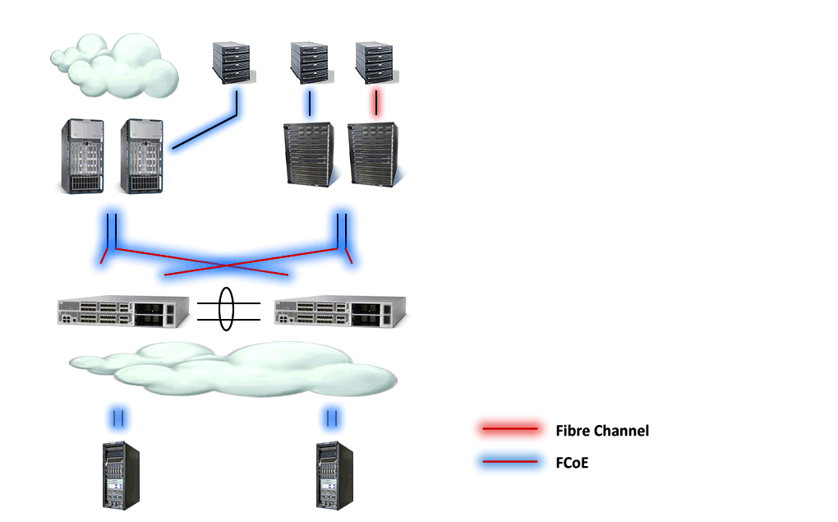
Unified Fabric - Phase 2
Unified Fabric in the Data Center
Once FCoE-enabled modules become available on the Nexus 7000 or the MDS 9500 series platforms, multi-hop FCoE topologies may be possible by retaining FCF capabilities across the different platforms
Additionally, with the introduction of direct FCoE
attached targets, these may also be directly
connected to any of these FCoE-enabled devices...

Slide 18
AGENDA
Introducción FCoE
Nexus Update
Arquitectura General
Diseños

Slide 19
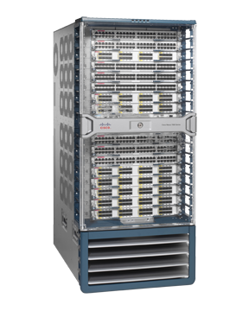
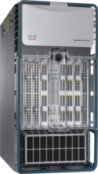
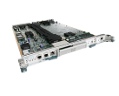
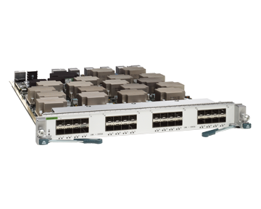


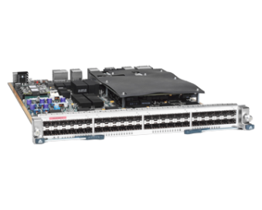
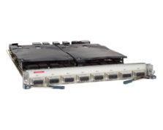
Nexus 7000 Platform Overview
Nexus 7018
Nexus 7010
Nexus 7000 and NX-OS
10 & 18 Slot versions
15+ Terabit System
Unified Fabric Ready
Modern, Modular OS
Device Virtualization
Cisco TrustSec
Continuous Operations
Supervisor
10G Ethernet
32 Port SFP+ 10G
8 Port X2 10G - XL
1G Ethernet
48 Port 10/100/1000
48 Port 1G - XL
10G Ethernet
DCB/FabricPath
32 Port SFP+ 10G
Linecard Modules
Cisco NX-OS Multi-protocol Operating System
Data Center Network Manager (DCNM)
Notes:
19
19

Slide 20
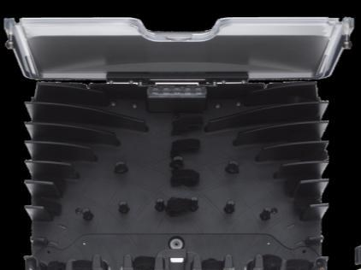
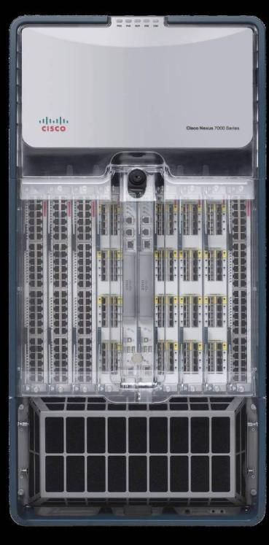
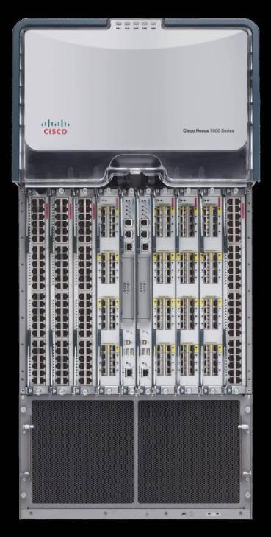
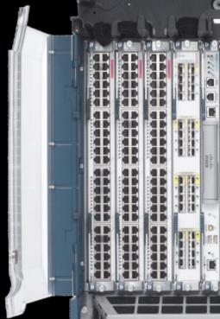
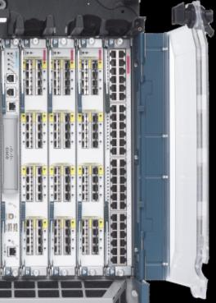
Nexus 7000 10-Slot Chassis
Air outlet
(rear/top)
System status LEDs
Cable Management
Linecard slots (8)
Supervisor slots (2)
Fans
(2 system + 2 fabric)
Fabric modules
(up to 5)
21 RU 36.75” (934mm)
Module Ejector
Release Buttons
Lockable Front
Doors (opt)
Power Supplies
(up to 3)
Air Filters (opt)
Chassis depth 30” (762mm)
17.3” (439mm)
Air intake
(front/bottom)

Slide 21
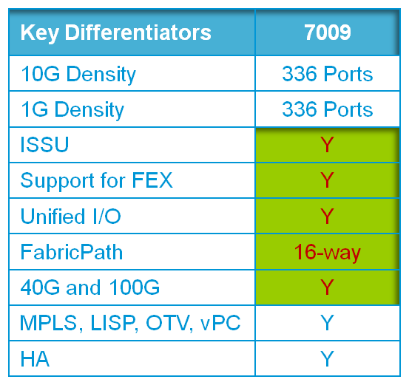
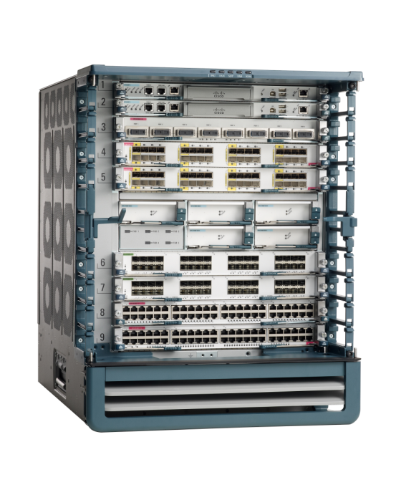
New Cisco Nexus 7009
Allow for transition from 6509 to Nexus 7009 in existing environments
Software Support in NX-OS 5.2(x) Delhi maintenance
14RU high, 24” deep, with side-to-side airflow, 2 Post Mounting
2 supervisor slots (slots 1 and 2)
7 I/O module slots (slot 3 – 9)
Supports all N7K I/O modules, Supervisor, and Power Supplies
5 fabric slots at front center of chassis
  Next-Gen fabric module delivering 110 Gbps per slot per fabric
  550 Gbps per slot w/5 fabrics using Fab-2
2 power supplies (installed from rear)
1 fan tray (installed from rear)
Notes:
Transcript:
And then the 7009. Now the 7009 software will be in the Delhi maintenance release, so it won't actually be in the June time frame, but we're going to have a maintenance release in Delhi, 5.2, for support of the 7009 chassis. The actual shipment of the chassis is going to be in Q4 of this calendar year, but the software will be in the Delhi maintenance release. So the 7009 really lends the Nexus 7000 family to smaller, more compact data centers, with 14 RU-- the same size as a 6509. And very efficient use of space, and using the existing supervisors, using the existing I/O modules, and using the existing power supplies. We're going to be coming out with the FAB2 as the first Fabric for the 7009. So this is up to 550 gigabits per second per slot for the 7009 platform.

Slide 22
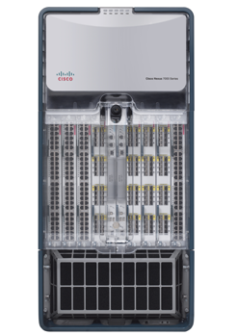




15Tb+ System Performance
Bandwidth Scales with Each Fabric Module
Fabric
Modules (FAB 2)
10, 40, 100 GbE Module
80G
110Gbps
220Gbps
550Gbps
330Gbps
550G
440Gbps
230G
Per Slot
46G
Investment Protection and Unified Fabric
Notes:
22
Fix color

Slide 23




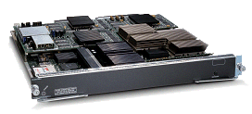



Next Generation Service Module Strategy
Today
6500 Service node
CY2011
6500 Service node
CY2012+
6500 & Nexus 7000
FWSM
ASA SM
NG FW For N7K
Security
10+ Gbps Performance
ASA Software Parity
40Gbps Forwarding
1000 contexts
2x
Common HW Platform for FW, NAM
NG NAM For N7K
Application Visibility & Monitoring
NAM
NAM10
20Gbps Monitoring
10+ Gbps
2x
ACE30
Application Delivery
40Gbps Forwarding
300K CPS
ACE
Data plane unification with appliance
HTTP Compression
Notes:
Transcript:
For service modules, today we recommend that you use either the 6500 as a service node or service appliances-- firewalls, NAM modules, ACE appliances. In the second half of 2012 we will have a service module for the Nexus 7000. Now this'll be 2x the performance of trifecta, which is being planned and shortly will be available on the Catalyst 6500. So we're talking about an ASA firewall, 40 gigabits per second of throughput, 1,000 contexts. And this particular hardware module will be the host for many different service modules. So we mentioned the ASA firewall, we'll also have NAM software running on the Bare Metal. And when I use the term Bare Metal, that's because we're also planning some virtual services for this service plate as well. So when we run virtualization on this service module, we can also host a bunch of virtual services. As you know if you've been keeping up with the services technology, a lot of the services are going virtual, and so this blade will be the perfect host for virtual service modules, such as VASA, vNAM and V everything else, if you will. So a lot of exciting capabilities coming out for services on the Nexus 7000.

Slide 24
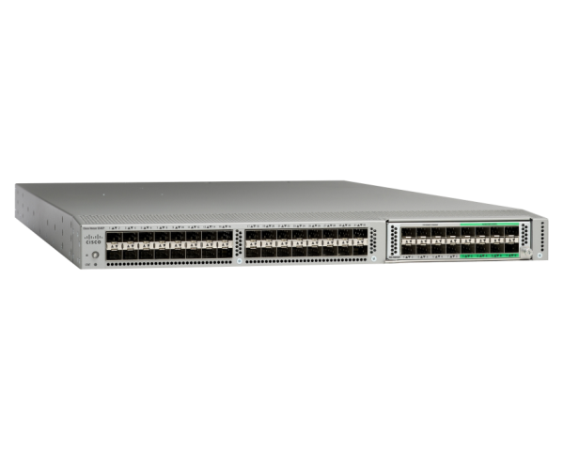

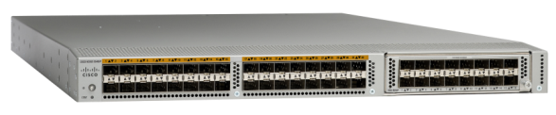

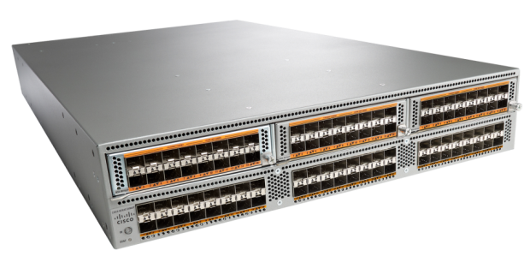

Cisco Nexus 5500
Base 32 ports are Ethernet/FCoE Ports
1 Expansion Slot
2 750W PS, 2 Fans
Base 32 ports are “Unified” Ports
1 Expansion Slot
2 750W PS, 2 Fans
List Price (32p)
$25,600
List Price (32p)
$25,600
Base 48 ports are “Unified” Ports
3 Expansion Slots
2 1100W PS, 4 Fans
List Price (48p)
$36,800
Notes:
Transcript:
The three key switches that I would really like you guys to focus on moving forward are the 5548P switch. So there's two 1-rack unit switches and one 2-rack unit switch. The 5548P switch-- this is a switch that we introduced last September. It gives you 32 ports on the base form factor with an additional capability of a module and you can go all the way up to 48 ports in 1-rack unit. The second switch on the right is the 5548UP switch. The key difference between the 48P and the 48UP is the concept of unified ports that we just talked about in the previous slide. With this the base 32 ports are unified ports and then you also get the same capability to add an expansion module to get a total of 48 ports. Prices for both the 5548P and the 5548UP are identical. So they're priced at $25,600 for 32 ports. And then the third switch at the bottom, this is the 2 rack unit switch. It comes with a base 48 ports and then you have three additional slots, so you can go all the way up to 96 ports in a 2 RU form factor. This is the industry's highest density fixed form factor switch in its class. No one else in the industry is delivering this type of density and functionality in a single six form factor box. So if you can imagine what this does, those 96 ports that you have in a 2 RU form factor, you can mix and match them. You can almost make this half of the switch. You can carve this as a Fibre Channel switch. The other half you can carve as an Ethernet switch. Or you can do some combination of the two.

Slide 25
Unified Ports
N5K-P(config)# Slot 1
N5K-P(config-slot)# port 21-25 type FC
N5K-P(config-slot)# exit
1
A reload will be necessary for the Unified Ports to accept the change.
N5K-P(config)# copy run start
[########################################] 100%
N5K-P(config)# reload
2
N5K-P(config-sys-qos)# show interface brief |incl fc
fc1/21 1 auto on down swl -- --
fc1/22 1 auto on down swl -- --
fc1/23 1 auto on sfpAbsent -- -- --
fc1/24 1 auto on sfpAbsent -- -- --
fc1/25 1 auto on sfpAbsent -- -- --
3

Slide 26
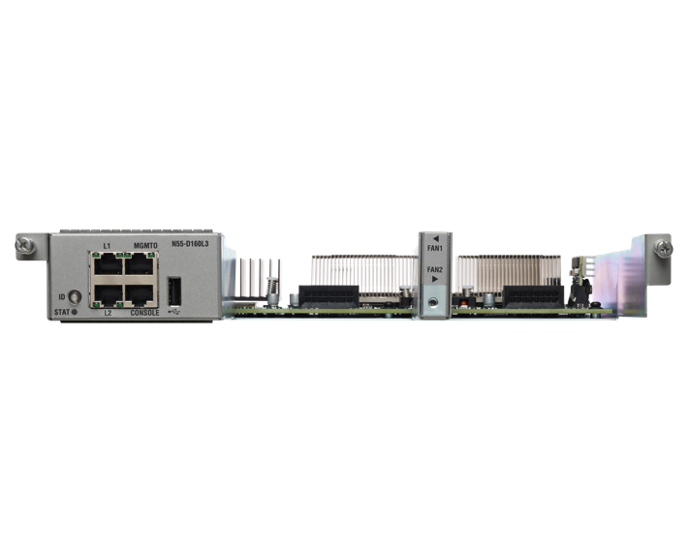
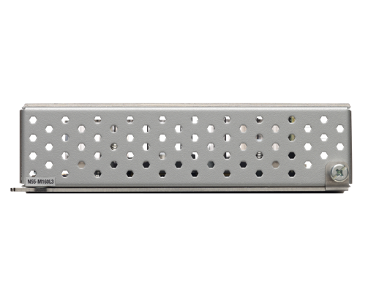
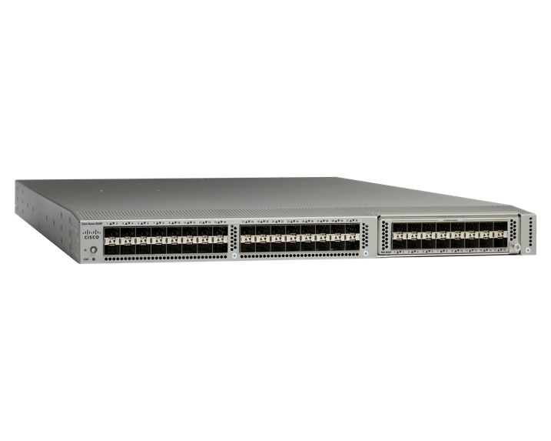
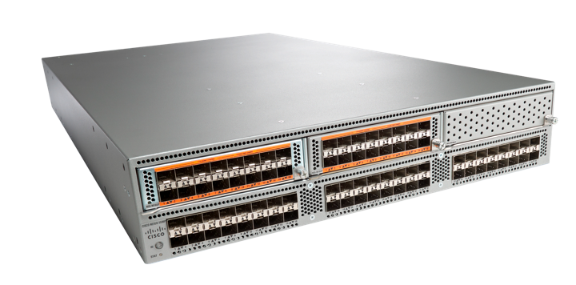
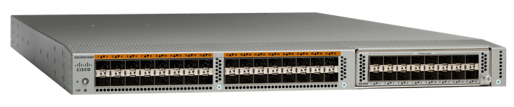
Cisco Nexus 5500 Layer 3
L3 Hardware
List Price
$5,000
L3 Hardware
List Price
$5,000
Nexus 5548P
Nexus 5548UP
Nexus 5596UP
Nexus 5548P
Nexus 5548UP
Nexus 5596UP
Notes:
Transcript:
Let's talk quickly about Layer 3 on the Nexus 5500 platform. So Layer 3 is now offered in two different form factors. They're identical performance but the form factor itself is different due to them being put into a 1-rack unit chassis and a 2-rack unit chassis. So if you focus on the left-hand side of the slide, we're showing you the Layer 3 offering on a 1-rack unit chassis, whether that's a 5548P chassis or a 5548UP chassis. What we offer is what's called a Layer 3 daughter card that goes on the other side of the chassis, which is the front side. It is field upgradable and it is listed at $5,000 for the hardware. Similarly for the 5596UP on the right side, the Layer 3 will be offered as a module, so it will use up one of the extra slots within the chassis. And that is also priced as $5,000 for the hardware. The software licensing comes in two tiers.

Slide 27


Data Center Access Layer Options
Top of Rack (ToR)
Typically 1-RU servers
1-2 GE LOMs
Mostly 1, sometimes 2 ToR switches
Copper cabling stays within rack
Low copper density in ToR
Higher chance of East-West traffic hitting aggregation layer
Drives higher STP logical port count for aggregation layer
Denser server count
Middle of Row (MoR) (or End of Row)
May be 1-RU or multi-RU servers
Multiple GE or 10GE NICs
Horizontal copper cabling for servers
High copper cable density in MoR
Larger portion of East-West traffic stays
in access
Larger subnets → less address waste
Keeps agg. STP logical port count low
(more EtherChannels, fewer trunk ports)
Lower # of network devices to manage
Notes:
27

Slide 28
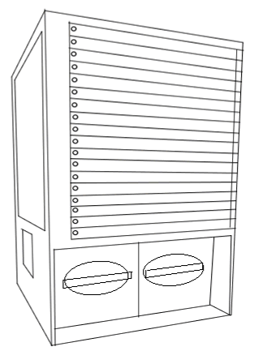
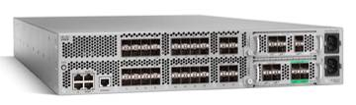
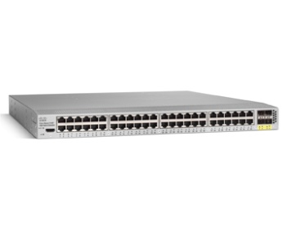
Nexus 2000 Fabric Extender
Virtual Chassis
Nexus 5000
Virtualized chassis
Nexus 5000
+
=
Nexus 2000 Fabric Extender
The Nexus 2000 Fabric Extender (FEX) acts as a remote linecard
for the Nexus 5000, retaining all centralized management and configuration
on the Nexus 5000, transforming it into a Virtualized Chassis
Notes:
28

Slide 29
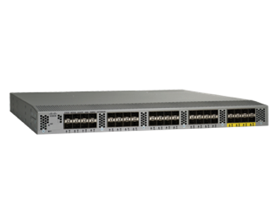
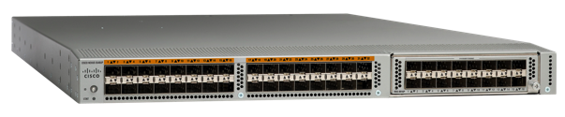
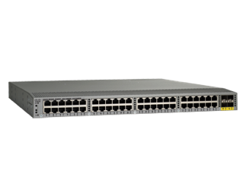
Cisco Nexus 5500 with Nexus 2200
Layer 2 Scaling
Layer 3 Scaling
24 x
FEX
8 x
FEX
In Layer 2 Mode, with NX-OS release 5.0(3)N1(1B), each Nexus 5500 is capable of supporting up to 24 Nexus 2000 Series Fabric Extenders, corresponding to
In Layer 3 Mode (with L3 License enabled), each Nexus 5500 is limited to supporting up to 8 Nexus 2000 Series Fabric Extenders, corresponding to
1152 1 Gigabit Ethernet Ports
768 10 Gigabit Ethernet Ports
384 1 Gigabit Ethernet Ports
256 10 Gigabit Ethernet Ports
Notes:
Transcript:
One thing I want to note here--

Slide 30
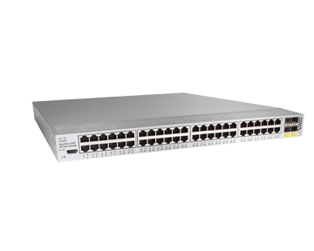
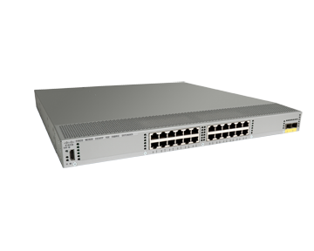
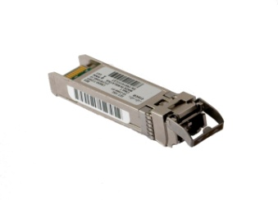
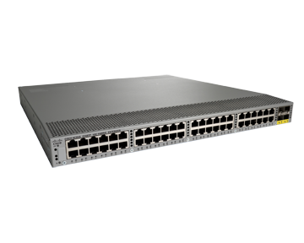
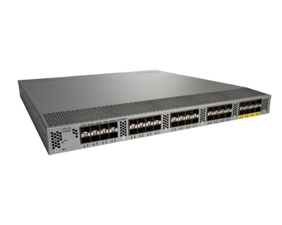
Cisco Nexus 2000 Series
Platform Overview
N2148T
48 Port 1000M Host Interfaces
4 x 10G Uplinks
N2224TP
24 Port 100/1000M Host Interfaces
2 x 10G Uplinks
FET-10G
Cost Effective Fabric Extender Transceiver
N2248TP
48 Port 100/1000M Host Interfaces
4 x 10G Uplinks
N2232PP
32 Port 1/10G FCoE Host Interfaces
8 x 10G Uplinks
Notes:
Transcript:
Today we have four platforms. We have the 2148, 2248, 2224, and 2232. And also very important to the whole product family is the FET-10G. It is actually very important because this is the transceiver that gives you the cost-effective solution when connecting the fabric extender to the parent switch. So where are we going next with the fabric extender?

Slide 31
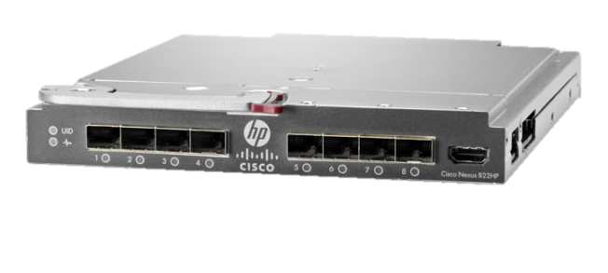

DC Design Details – Blade Chassis
Nexus B22 Series Fabric Extender
B22 extends FEX connectivity into the HP blade chassis
Cisco Nexus 5000 Switch is a single management point for all the blade chassis I/O modules
66% decrease in blade management points*
Blade & rack networking consistency
Interoperable with Nexus 2000 Fabric Extenders in the same Nexus parent switch
End-to-end FCoE support
Support for 1G & 10G, LOM and Mez
Dell supports Pass-Thru as an alternative option to directly attaching Blade Servers to FEX ports
Cisco Nexus B22 Series Blade FEX
Nexus 5500 + B22 (HP FEX)
Notes:
31

Slide 32
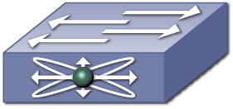
Blade Center Supported Unified Topology
Typical Unified Topology
Provides Unified I/O from the blade server
FCoE perspective, still preserves dual Fabric environment
LAN admins still manage device as another network switch
SAN admins manage the fabric with normal SAN tools
Hardware Requirements
Nexus 4000 (aka Eckhart)
FCoE Switch (Nexus 5K or Brocade 8K)
Software Requirements
Nexus 4000 – Release version X
Nexus 5000 – NX-OS 4.1(3)N1(1)
LAN
SAN A
SAN B
N5K
N5K
N4K-1
N4K-2
N4K-1
N4K-2
Blade Chassis
Blade Chassis
Enhanced Ethernet and FCoE
Ethernet
FC
Notes:
32

Slide 33
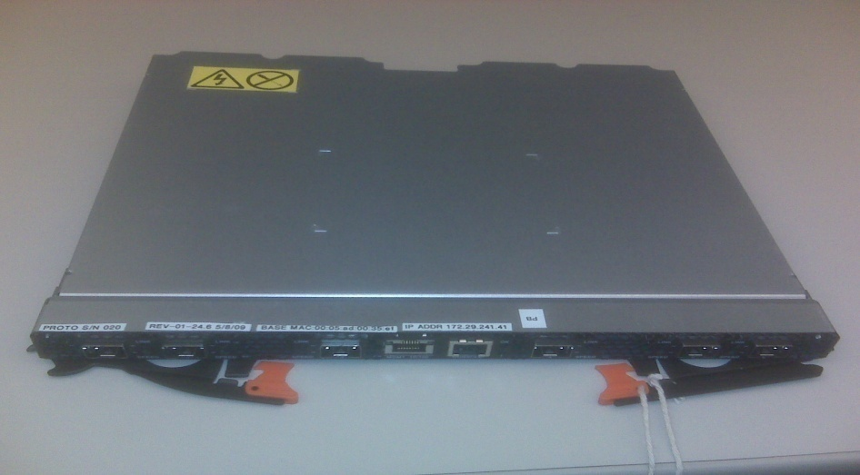
Nexus 4001I Switch Module
14 x 10G downlinks & 6 x10G uplink
Dual-mode all ports (1G/10G)
RJ-45 Management interface
RS-232 Console port
high-speed slots (HSS) in BCH/BCH-T
Max of Four 4001I per chassis
Support CX1 SFP+, SR, LSR optics
10G uplink ports
Console
Key Benefits & Applications
Management
Ejector Handles
Consolidate Infrastructure w/ Unified IO
Consistent Low-latency
Scale Bandwidth with 10G & Multi-pathing

Slide 34
High Level NX-OS Architecture
Layer 3 Protocols
Layer 2 Protocols
Storage Protocols
OSPF
MSDP
VLAN
UDLD
VSANs
Zoning
BGP
IGMP
SPAN
CDP
HA Manager
FCIP
FSPF
EIGRP
HSRP
STP
VTP
IVR
…
PIM
SNMP
LACP
CTS
…
…
Future
System Infrastructure
Linux Kernel
Linux kernel provides preemptive multitasking, virtual memory, multithreading, SMP, etc.
System infrastructure and HA manager leveraged from SAN-OS: Reliable messaging, state database, process management/monitoring
Modern, streamlined, scalable Layer 3 protocol implementation
Data-center focused, standards-based Layer 2 feature set
Storage protocols will “plug in” to NX-OS in future
  Implementation taken directly from SAN-OS

Slide 35
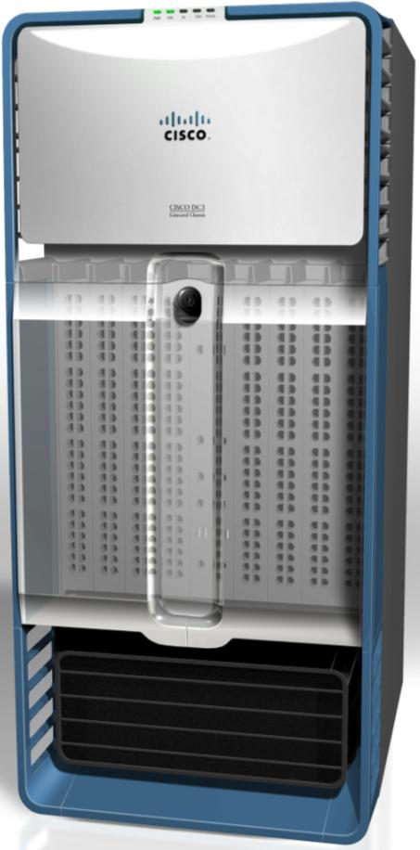
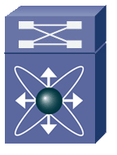
Stateful Fault Recovery
Restart process!
Software RIB
STP
IPv6
HSRP
TCP/UDP
LACP
OSPF
etc
BGP
PIM
HA Manager
Linux Kernel
Table
Update
N7K Data Plane
If a fault occurs in a process…
HA manager determines best recovery action (restart process, switchover to redundant supervisor)
Process restarts with no impact on data plane
  State checkpointing (PSS) allows instant, stateful process recovery
  Software utilizes Graceful Restart where appropriate
Hardware FIB

Slide 36
In-Service Software Upgrade
N7K# install all kickstart bootdisk:4.1-kickstart system bootdisk:4.1-system
N7K#
Needed for animation, don’t remove!
N7K#
Upgrade and reboot
Initiate stateful failover
Upgrade and reboot
Upgrade and reboot I/O modules
Active
Active
Standby
Release 4.0
Release
4.1
Release
4.1
Release 4.0
Standby
OSPF
BGP
PIM
etc.
OSPF
BGP
PIM
etc.
HA Manager
HA Manager
Linux Kernel
Linux Kernel
N7K Data Plane
Release 4.0
Release
4.1
I/O Module Images

Slide 37

Nexus 7000 Virtualization with VDCs
VDC 1
VDC 2
VDC 1
Layer 2 Protocols
Layer 3 Protocols
Layer 2 Protocols
Layer 3 Protocols
VDC 2
VDC 3
VLAN
UDLD
OSPF
GLBP
VLAN
UDLD
OSPF
GLBP
PVLAN
CDP
BGP
HSRP
PVLAN
CDP
BGP
HSRP
VDC 4
STP
802.1X
EIGRP
IGMP
STP
802.1X
EIGRP
IGMP
LACP
CTS
PIM
SNMP
LACP
CTS
PIM
SNMP
…
…
…
…
Infrastructure
Kernel
VDC – Virtual Device Context
Flexible separation/distribution of hardware resources and software components
Complete data plane and control plane separation
Complete software fault isolation
Securely delineated administrative contexts
Forwarding engine scalability with appropriate interface allocation

Slide 38

Virtual Port Channel - vPC
vPC is a Port-channeling concept extending link aggregation to two separate physical switches
Allows the creation of resilient L2 topologies based on Link Aggregation.
  Eliminates the need for STP in the access-distribution
Provides increased bandwidth
  All links are actively forwarding
vPC maintains independent control planes
Physical Topology
Logical Topology
Virtual Port Channel
L2
Non-vPC
vPC
Increased BW with vPC
Notes:
MEC is mandatory feature – VSS is not possible with MEC-
May be show singly attached to DUAL attached with MEC and NON-MEC
Add MEC Slide requirement for avoiding loop for BP design - Requires EC on Access
Modify the picture – with logical at bottom and Physical designation

Slide 39

FabricPath
Forwarding not based on mac addresses inside the Fabric
Frames load balanced across up to 256 links for maximum BW
Classical Ethernet
Mac Address Table
Fabric
S11
S42
FabricPath
MAC | IF
A | xx
… | …
B | yy
Classical Ethernet
A
A single Mac address lookup at the edge
B
“Unlimited” bandwidth
16 ways ECMP, up to 256x 10G links between 2 boxes, 160Tbps Fabric
A single mac address lookup at the edge, then forwarding based on 12 bits up to the remote port
Traffic goes across the shortest path
Fast convergence, high resiliency

Slide 40



Overlay Transport Virtualization
Ethernet encapsulado en IP
Extiende la LAN entre Data Centers sobre IP (MAC sobre IP)
Ideal para Long distance vMotion y Site Recovery Manager
Transparencia Operacional para la administración de las direcciones de IP de las VMs.
Conexiones entre DataCenters establecidas de manera automática y dinámica.
Disponible en Nexus 7000
http://tools.ietf.org/html/draft-hasmit-otv-03
Notes:
SOLO PARA SERVICE PROVIDERS..
Site Recovery Mgr
Long Distance vMotion
Pronto para el ASR 1000..
Link para los que les guste leer el draft presentado a la ietf.

Slide 41


Architecture Flexibility Through NX-OS
Spanning-Tree
vPC
FabricPath
Active Paths
Single
Dual
16 Way
POD
Bandwidth
Up to 10 Tbps
Up to 20 Tbps
Up to 160 Tbps
Layer 2 Scalability
Infrastructure Virtualization and Capacity
Notes:
Purpose of this slide:
Show the alignment between Cisco’s data center 3.0 strategy and Cisco IT’s drive to Cloud Services.
Key Messages:
IT issues today include lack of flexibility, agility, security and automation required to keep pace with rapidly changing business demands.
Cisco IT has standardized on virtual machines as the new atomic unit in compute and is driving the transition to cloud based services.
This disruptive journey is also an excellent time to examine your corporate environment for optimization at every stage.
Optimize and Consolidate – Standardize and eliminate all redundant or overlapping infrastructure
Optimize with Virtualization – Decommission overlapping applications- Just because one can virtualized 20 physical servers and their applications onto a single server, do not blindly migrate the applications leverage this disruptive instance to eliminate all overlapping applications
Optimize and Automate – Great opportunity to improve efficiency and effectiveness of every business process. One does not want to make bad decisions faster.
Beyond automation, you begin to enter the next level of IT refinement with robust utility pay-as-you-go services offered within:
Enterprise intranet-class cloud utility services and
Inter-cloud go-to-market value deliver chain services for development and delivery of customer consumables.

Slide 42







Nexus 1000V Brings VM Level Granularity
Network Hurdles to Virtualization
vMotion moves VMs across physical ports—the network policy must follow
Hypervisor
Hypervisor
Impossible to view or apply network policy to locally switched traffic
VLAN
101
Need collaboration between network and server Teams
Virtual Center
Nexus 1000V
VSM
Notes:
Let’s look into this in more detail…
VM Visibility
VM Isolation
Workflow
The Cisco Nexus 1000V overcomes these hurdles…

Slide 43






Cisco Nexus 1000V Components
vCenter Server
Cisco VSMs
Virtual Ethernet Module(VEM)
Replaces Vmware’s virtual switch
Enables advanced switching capability on the hypervisor
Provides each VM with dedicated “switch ports”
Virtual Supervisor Module(VSM)
CLI interface into the Nexus 1000V
Leverages NX-OS 4.04a
Controls multiple VEMs as a single network device
Cisco VEM
Cisco VEM
Cisco VEM
VM1
VM2
VM3
VM4
VM5
VM6
VM7
VM7
VM9
VM10
VM11
VM12
Notes:
Transcript:
It is NX-OS based so CLI is very similar to the 7000, the MDS, the 5000 (inaudible). At day one we'll have a single option for going to VSM which would be a virtual appliance, and we'll talk about that in a little more detail throughout the presentation. The second component is what we call the Virtual Ethernet Module. This is the component that actually gets installed on the ESX server itself. This replaces the virtual switch functionality that customers expect to see in the VMware environment. And it enables us to provide our rich Cisco feature set in this environment. This piece of code is extremely small. It's only a few megabytes of code, and it doesn't really take up a whole lot of memory or resources on the system itself.

Slide 44



Cisco Nexus 1000V ‘Virtual Chassis’
pod5-vsm# show module
Mod Ports Module-Type Model Status
--- ----- -------------------------------- ------------------ ------------
1 0 Virtual Supervisor Module Nexus1000V active *
2 0 Virtual Supervisor Module Nexus1000V ha-standby
248 Virtual Ethernet Module NA ok
248 Virtual Ethernet Module NA ok
Cisco VSMs
Cisco VEM
Cisco VEM
VM1
VM2
VM3
VM4
VM5
VM6
VM7
VM8
Notes:
Transcript:
So the model we have is, from a management perspective, a virtual chassis model. This is to say that a single Nexus 1000V is comprised of two VSMs and multiple VEMs that look like a single chassis. AUDIENCE QUESTION: Hey Dan? Yes. AUDIENCE QUESTION: We're finding that a number of people can't hear you quite as well. Can you speak up a little bit more? I know we did the sound check earlier, but there are some saying that your voice is a little bit low. Okay, we'll try to increase the volume as possible. AUDIENCE COMMENT: Thanks Dan. Okay, hopefully this is a little better for you. So as I was saying, the Cisco Nexus 1000V employs a virtual chassis model where the two Virtual Supervisor Modules and the multiple Virtual Ethernet Modules comprise a single chassis. So when you do show module for example, this is the output that you would expect to see. Each Virtual Supervisor Module shows up as a module in the chassis, and then any number of Virtual Ethernet Modules that you may have deployed would show up as modules in the chassis as well up to the 64 that we'll be supporting at FCS.

Slide 45



Port Profile Policy Distribution
n1000v(config)# port-profile WebServers
n1000v(config-port-prof)# switchport mode access
n1000v(config-port-prof)# switchport access vlan 100
n1000v(config-port-prof)# no shut
Cisco VSM
PP
vCenter Server
Notes:
Transcript:
So the way that this works from a collaborative perspective is the network administrator defines a port-profile. That port-profile is configured on the VSM through the standard Cisco CLI. That profile gets rolled up. The network administrator says, make this a VMware port group. That port-profile name gets pushed out to Virtual Center and then it will be displayed within the drop-down that the server administrators use to configure their network interfaces on their virtual machines. Now they'll see the name of the port-profile and the name of the switch, in this case that Nexus 1000V that it's associated with. And when that virtual machine comes up, the switch will automatically create a virtual Ethernet interface for that virtual machine or corresponding to each virtual NIC. And the policy that is applied is the policy that was defined within the port-profile that the server administrator has used. So this is a very collaborative model between server and network administrators.

Slide 46

Nexus 1000v

Slide 47




Cisco Nexus 1000V
Consistent Architecture across Hypervisors
VM
VM
VM
VM
VM
VM
VM
VM
Nexus
1000V
VEM
Nexus
1000V
VEM
VMware vSphere
Windows 8 Hyper-V
Nexus 1000V
VSM
Nexus 1000V
VSM
VMware vCenter
SCVMM
Consistent architecture, feature-set, network services & Nexus 1010 ensures operational transparency across multiple hypervisors.

Slide 48


Fabric Extender Evolution
Distributed Modular System to the ToR, server and Virtual Machine
One Network
Virtual Same As Physical
Network
Administrator
VM-FEX
Consolidates virtual and physical network
Each VM gets a dedicated port on switch
Uses Pre-standard IEEE 802.1BR
IEEE 802.1BR*
FEX
IEEE 802.1BR*
IEEE 802.1BR*
Hypervisor
VM network managed by
Server
administrator
Legacy
Adapter FEX
VM-FEX
*IEEE 802.1BR pre-standard

Slide 49







Defense in Depth Security Model
Virtual Security
Policy applied to VM zones
Dynamic, scale-out operation
VM context based controls
VSG
Segment internal network
Policy applied to VLANs
Application protocol inspection
Virtual Contexts
Internal Security
FWSM
ASA 55xx
Internet
Edge
Filter external traffic
Extensive app protocol support
VPN access, Threat mitigation
ASA 55xx

Slide 50




Virtual Security Gateway
Intelligent Traffic Steering with vPath
VNMC
VM
VM
VM
VM
VM
VM
VM
VM
VM
VM
VM
VM
VM
VM
VM
VM
VM
VM
VM
4
Nexus 1000V
Distributed Virtual Switch
vPath
Decision
Caching
VSG
3
2
Flow Access Control
(policy evaluation)
Initial Packet
Flow
1
Log/Audit

Slide 51
Virtual Security Gateway
Performance Acceleration with vPath
VNMC
VM
VM
VM
VM
VM
VM
VM
VM
VM
VM
VM
VM
VM
VM
VM
VM
VM
VM
VM
Nexus 1000V
Distributed Virtual Switch
vPath
VSG
ACL offloaded to
Nexus 1000V
(policy enforcement)
Remaining packets from flow
Log/Audit

Slide 52




Virtualization & Cloud Driving New Requirements
Dedicated Network Services
Virtual Network Services
App
VDC-1
App
App
OS
OS
OS
Hypervisor
VDC-2
Firewall
SLB/ADC
WAN Opt
Application-specific services
Form factors:
  Appliance
  Switch module
Virtual Service Nodes (VSNs)
Virtual appliance form factor
Dynamic Instantiation/Provisioning
Service transparent to VM mobility
Support scale-out
Large scale multi-tenant operation

Slide 53
















Cisco Data Center Network Manager
Single Pane of Glass Visibility Across Cisco LAN & SAN
Fault Management
Resource Management
Change Management
Provisioning/Configuration
API Integration
Security RBAC
Unified Fabric
Data Center Networks
MDS 9000 Series Switches
Nexus 1010 Appliance
Nexus 7000 Series Core Switches
Catalyst 6500 Series Switches
Catalyst 4900 Series Switches
UCS Series Fabric Interconnects
Firewall Services Module
Storage
Nexus Access Series Switches
Network
http://www.cisco.com/go/dcnm
Notes:
IT departments today are challenged to look beyond traditional silos of networking and storage to manage this converged, virtualized data center. Meeting this challenge calls for unification of the management plane to enable holistic management of the data center infrastructure. Recognizing the need to support this convergence in management, Cisco is merging two best-in-class management solutions, Cisco Fabric Manager and Cisco Data Center Network Manager (DCNM) for LAN, into one unified product called Cisco DCNM.
Cisco DCNM can be licensed to manage a combination of SAN and LAN environments. Administrators still maintain control and segmentation through role-based access control (RBAC), now with single-pane visibility across the network and storage access infrastructure. Depending on licensing, different features for management of SAN and LAN infrastructure are available.
Features of Cisco DCNM
DCNM assists in operational management of virtualized data centers by providing:
Data center oriented operational dashboards for SAN and LAN health and performance
Proactive monitoring of SAN and LAN health and events/alerts that can be forwarded to customer OSS/BSS
Performance monitoring and thresholding. Long term trending and capacity planning
DCNM features an innovative new technology called VMPath that provides unprecedented visibility into the network path starting from a virtual machine through the compute and network (SAN) layers all the way to storage ports and network services. This, coupled with end to end performance views enables quick troubleshooting performance bottlenecks and network issues.
Cisco DCNM streamlines the provisioning of the unified fabric by means of template based provisioning for all of key NX-OS features including that of multi-hop FCoE.
DCNM provides comprehensive coverage for provisioning and monitoring of data center networks built using Cisco Nexus®, Cisco Unified Computing System™, and Cisco MDS 9000 Family products, Cisco DCNM is the Cisco recommended solution for managing mission-critical data centers.
Benefits of Cisco DCNM
By providing a single pane of glass visibility across both SAN and LAN environments, DCNM lowers the total cost of operating (TCO) Cisco data centers .
Features such as operational dashboards, performance views and Vmpath enable proactive monitoring and diagnostics and thereby simplify operational management of virtualized data centers.
DCNM provides coverage for deploying a wide variety of NX-OS innovations using easy to use wizards or using templates (for scale, consistency and programmability).
All these features can be accessing using very intuitive web based dashboards or by using a robust set of web services API which can be used to integrate with customers’ enterprise management systems.
For more information about the Cisco DCNM software, send an email to ask-dcnm@ cisco.com, visit the product homepage at www.cisco.com/go/dcnm, or contact your local account representative.

Slide 54
AGENDA
Introducción FCoE
Nexus Update
Arquitectura General
Diseños

Slide 55

DC Designs
Nexus & NX-OS Differentiation
DR Data
Center
VM
#2
VM
#3
VM
#4
OTV: Layer 2 Extension
VDC: Virtual Device Contexts
NX-OS – Modular Operating System common across the DC
ISSU – True non-stop operations
DCNM – Consolidated Configuration and Management
FCoE
This is an Animated Slide
FC
Unified Fabric:
Multi-Hop FCoE
Unified Ports
FEX Architecture
Host Facing vPC
FET + FEX: Cabling cost efficiencies
Nexus 1000v & vPath
VSG, vWAAS
Virtualized Interfaces Adapter FEX, VM-FEX & FCoE
VM
#2
VM
#3
VM
#4

Slide 56
Preguntas

Slide 57
Muchas Gracias

